Slide 1
Ram Babu Gupta GmbH
We Sell Happiness
High-end acquisition strategy
for Jennifer Montgomery
Notes:
Open with the thesis, not the agenda: the waterfront flag is not what makes a house expensive here — the view grade is. Two numbers frame everything that follows, 30 days to sign and 12 months to exit. Say the evidence is 17,335 King County sales, cleaned first, and the method is deliberately descriptive: counts, medians, group comparisons, maps. No regression. Ten minutes, roughly one per slide.

Slide 2
KING COUNTY · 17,116 SALES
The view,
not the address.
High-end acquisition strategy
for Jennifer Montgomery
30 days to buy · 12 months to sell
Notes:
Open with the thesis, not the agenda: the waterfront flag is not what makes a house expensive here — the view grade is. Two numbers frame everything that follows, 30 days to sign and 12 months to exit. Say the evidence is 17,335 King County sales, cleaned first, and the method is deliberately descriptive: counts, medians, group comparisons, maps. No regression. Ten minutes, roughly one per slide.

Slide 3
THE BRIEF
Two deadlines decide everything.
12
30
months to resell
days of buy
Ram Babu · 2 / 9
Notes:
Frame the brief as a filter, not a wish list. The 30-day window removes renovation projects outright. The 12-month exit means we optimise for resale demand rather than long-run growth. Everything on the following slides is downstream of these three tiles — and the third one is a client constraint, not a finding, which matters later.

Slide 4
DEFINITIONS
Four words, four columns.
WATERFRONT
VIEW
POSH
CENTRE
1 or 0
Graded 0–4
Top 1%
5 km ring
Blanks read as 0.
4 is panoramic.
$1.97M and above.
Around 47.506N, 122.152W.
Ram Babu· 3 / 9
Notes:
Ten seconds on this slide. The only point worth making aloud: the first two are fields in the data, the last two are lines we drew ourselves. The top-1% cut and the 5 km ring are choices, so they are the first things to revisit if a result looks strange — and one of them does later. Turnkey is not on this slide because the data has no column for renovation quality.

Slide 5
WHAT I TESTED
Three claims. One dataset.
H1
H2
H3
Waterfront costs more than inland.
A better view costs more than a worse one.
The posh houses sit outside the centre.
Ram Babu · 4 / 9
Notes:
Each claim matches one of the client's criteria, so none is academic. Flag that H1 and H2 can pull apart: a waterfront address graded 0 for view may sell below an inland house graded 4, which is exactly why they are tested separately rather than merged into a single premium. That separation turns out to be the whole finding.

Slide 6
THE CLEAN-UP
21,597 in. 17,196 out.
Descriptive only.
2,391
4,363
177
blank waterfront flags, set to 0
rows dropped for missing values
re-sales, removed based on ids with old date.
Ram Babu · 5 / 9
Notes:
Card 1 is the assumption to declare out loud: filling 2,391 blanks with 0 enlarges the non-waterfront group, so if any of those were genuinely on the water, the premium on the next slide is understated. Card 2 breaks down as 3,848 missing renovation years, 452 basement areas and 63 view grades — dropped rather than imputed, which costs about one row in five but keeps comparisons clean. Card 3 is a known gap: the de-duplication is written but the working set was taken before it was applied, so fix that line before this goes in front of anyone. Card 4: thirty days does not allow for a model nobody has time to validate.

Slide 7
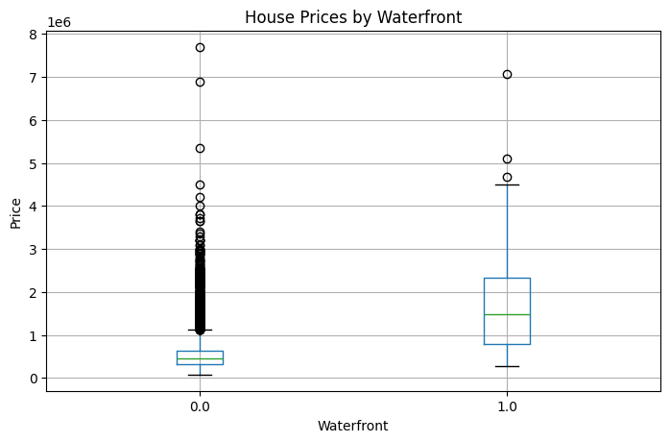
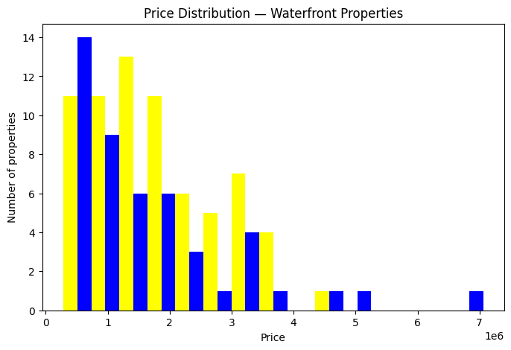
H1 — CONFIRMED: Waterfront costs more than inland.
3.3×
Median on the water: $1.49M. Only 116 of 17,335 homes qualify.
Ram Babu · 6 / 9
Notes:
Left: the two boxes are the middle half of each group, the line inside is the median. Right: how the 116 waterfront sales spread out, from 285 thousand to just over 7 million. Lead with the median, not the mean — a few very large sales pull the waterfront average to 1.72 million against 533 thousand inland, but the median is the number that survives questioning. The caveat to volunteer is sample size: 116 waterfront homes against 17,219 inland, so a handful of atypical sales moves this comparison.

Slide 8
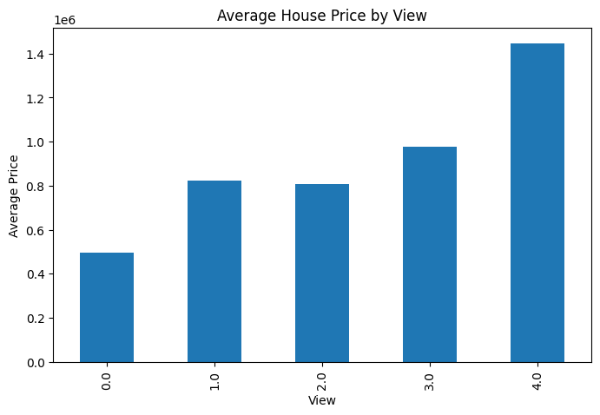
H2 — TRUE, BUT NOT A LADDER: A better view costs more than a worse one.
Only grade 4 pays.
~$1.45M
average at grade 4
Skip 1–3
the middle of the scale buys nothing
Ram Babu · 7 / 9
Notes:
This is the slide that changes the search brief, so give it the most time. The hypothesis holds in direction but not in shape: grade 0 averages about half a million, grades 1 and 2 sit level around 0.8 million, grade 3 adds little, and the price band only moves at grade 4. So "a better view" is not automatically worth money — one specific step is. Expect the question of how many grade 4 homes exist and how many are also waterfront; flag that cross-tabulation as the next thing to run.

Slide 9
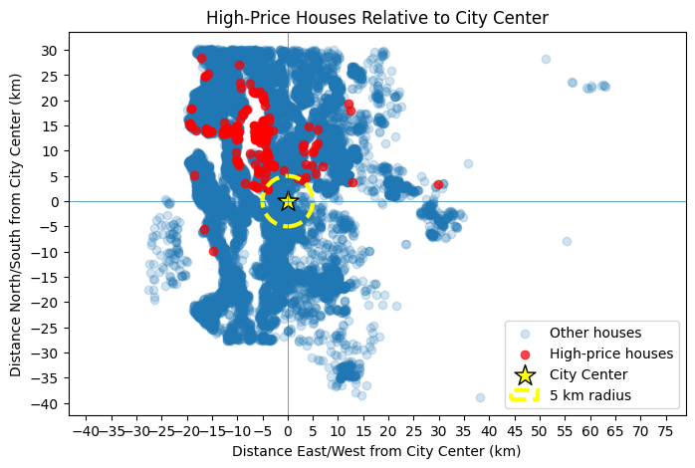
H3 — DIRECTIONALLY YES : The posh houses sit outside the city-centre.
An arc, not a ring.
5–20 km
north and north-west — where the $1.97M+ sales sit
99%
of all homes fall outside the ring
Ram Babu · 8 / 9
Notes:
Present this as directional evidence, not a settled result. What it does establish is where to search: an arc running north and north-west of the marker, roughly 5 to 20 km out. What it cannot establish is the centre-versus-suburb claim, because 16,517 of 17,335 homes land outside the ring and the reference point at 47.506 north, 122.152 west sits well east of downtown. If challenged on whether this kills the recommendation, the answer is no — the cluster is visible wherever the marker sits; only the inside-versus-outside wording depends on it.

Slide 10
THE NEXT 30 DAYS
Three moves.
01
Grade 4, or walk away.
A waterfront address without the view is an ordinary house.
02
Hunt the northern arc.
Resale in a year needs buyers already looking there.
03
Waterfront with views
Away from city center with waterfront views
Ram babu · 9 / 9
Notes:
Close on sequencing: turnkey is the filter applied first because it is non-negotiable, grade 4 ranks whatever survives it, and the northern arc breaks the remaining ties. Be explicit that move 3 rests on her deadline and not on the analysis — it is the one recommendation the data did not produce. Leave a minute for questions.

